Slide 1
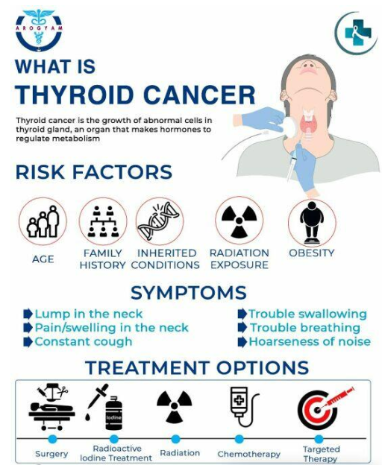
What is Thyroid Cancer and their risk factors?
Research Questions
What are the risk factors contributing to thyroid cancer and which one have the highest chance that led to thyroid cancer?
Who have the highest risk to develop thyroid cancer?

Slide 2
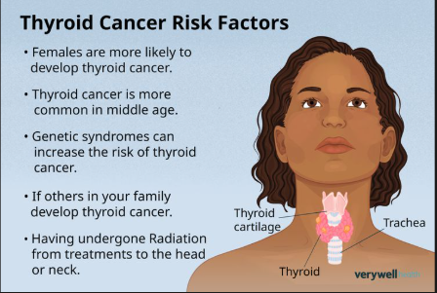
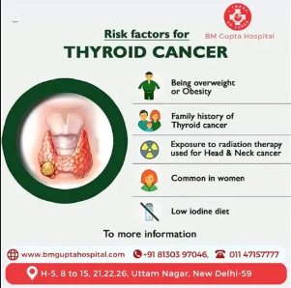
What is Thyroid Cancer and their risk factors?
Thyroid cancer occurs when DNA mutations cause cells in the thyroid to grow uncontrollably. The type of cancer depends on which cells mutate. There is no clear consensus on what causes these changes, but several risk factors have been associated with a higher chance of developing thyroid cancer.
RISK FACTORS for thyroid cancer includes:
Radiation Exposure
Age, Family History
Obesity
A low-iodine diet
Gender

Slide 3
Data Source and Methodology
Download dataset from kagglehub and analyzed data by using Python through Google Colab.
import pandas as pd
import seaborn as sns
%matplotlib inline
# Path to dataset files: /kaggle/input/encoded-thyroid-2
import kagglehub
path = kagglehub.dataset_download("bhargavchirumamilla/thyroid-cancer-risk-dataset")
df = pd.read_csv(f"{path}/thyroid_cancer_risk_data.csv")
Data Set Rows: 212K
Data Set Columns: 17 columns
Use Pandas library to clean up data, and seaborn, matlotlib, and tableau to create visual graph and chart.
Clean the DataFrame by dropping any rows with missing values and duplicated values, then group the data by the analysis columns

Slide 4
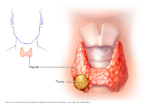

The motivation for me to perform analysis on the thyroid cancer is because I want to know what cause thyroid cancer. I never heard of thyroid cancer until I had it.
How common is thyroid cancer?
The American Cancer Society’s most recent estimates for thyroid cancer in the United States are for 2026:
About 45,240 new cases of thyroid cancer (13,240 in men and 32,000 in women)
About 2,320 deaths from thyroid cancer (1,100 in men and 1,220 in women)
Thyroid cancer is often diagnosed at a younger age than most other adult cancers. The average age when a person is diagnosed with thyroid cancer is 51.
This cancer is almost 3 times more common in women than in men. It is about 40% to 50% less common in Black people than in any other racial or ethnic group.
Trends in thyroid cancer statistics
Until recently, the rate of new thyroid cancers was growing faster than for any other cancer in the US.
This was largely because more thyroid tumors were being found during imaging tests such as CT or MRI scans that were done for other medical problems. These sensitive tests can sometimes detect small thyroid tumors that might not ever have been found otherwise (and many of which might never have caused any problems).
However, as doctors have started to use stricter criteria for diagnosing thyroid cancer, the incidence rate declined by 1.4% per year from 2013 through 2022.
The death rate for thyroid cancer has stayed about the same since 2009.
Statement from

Slide 5
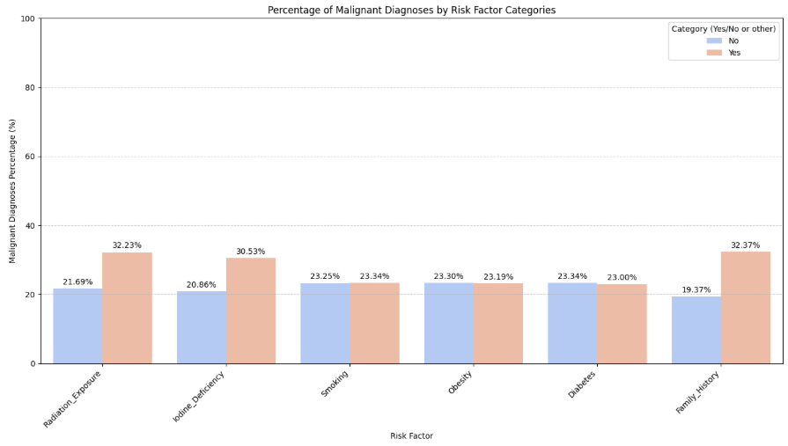
Analyze which thyroid cancer risk factors that has the highest risk that led to thyroid cancer, Family history and Radiation exposure

Slide 6
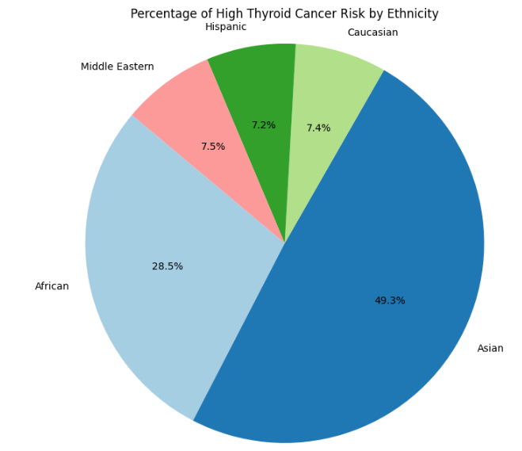
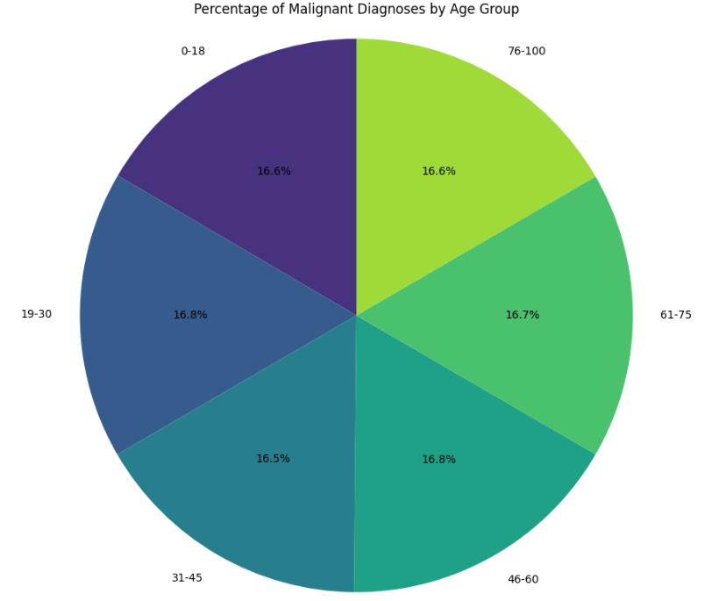
Ethnicity and age group that has the highest developing thyroid cancer is Asian and age between 20 to 60.

Slide 7
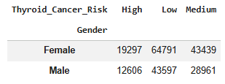
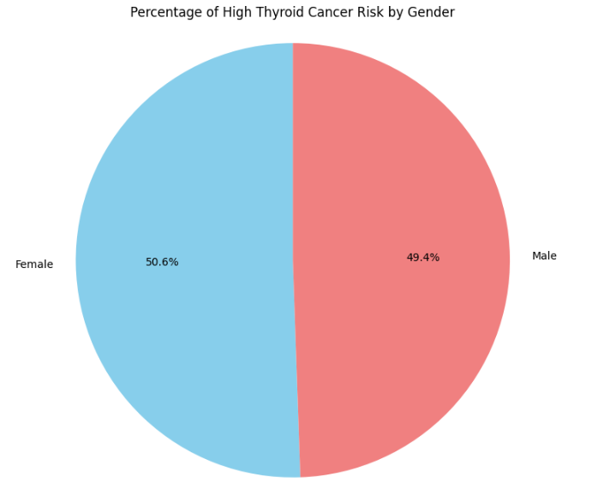
Female have the highest percentage to develop thyroid cancer
Women are about three times more likely than men to develop thyroid cancer.
https://www.cancer.org/
Age group most cases occur between 20 to 55 Thyroid Cancer Risks and Prevention - Brigham and Women's Hospital

Slide 8
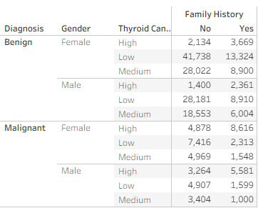
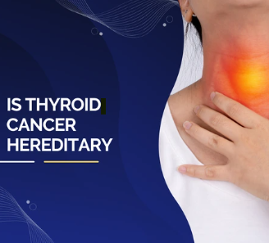
Based on the analysis of malignant percentages across different risk factors there are 2 rank the highest potential contribution to thyroid cancer, Family History with a malignant percentage of 32.37% and Radiation Exposure with a malignant percentage of 32.23%
Gender and age group that has the highest developing thyroid cancer is Female and between 20 to 60.
Asian ethnic group have 49.3% to develop thyroid cancer

Slide 9
Thyroid Cancer can be monitor and diagnosis through varies way.
Physical Exam and History: A doctor will check your neck for lumps or nodules and ask about your medical history, including any family history of thyroid cancer or radiation exposure.
Blood Tests: These tests measure the levels of thyroid-stimulating hormone (TSH) and other thyroid hormones (T3 and T4) to see if your thyroid is functioning properly. While these don't directly diagnose cancer, abnormal levels can indicate a thyroid problem.
Ultrasound: This imaging test uses sound waves to create detailed pictures of your thyroid. It helps to identify nodules, determine their size, location, and characteristics (e.g., solid or fluid-filled), which can help assess the likelihood of cancer.
Fine-Needle Aspiration (FNA) Biopsy: This is often the most definitive diagnostic test. A thin needle is inserted into the thyroid nodule (guided by ultrasound) to collect a small sample of cells. These cells are then examined under a microscope by a pathologist to check for cancerous cells.
Molecular Testing: In some cases, if the FNA results are inconclusive, additional molecular tests on the biopsy sample may be performed to look for specific genetic changes that are common in thyroid cancers.
Imaging Tests (less common for initial diagnosis, more for staging): CT scans, MRI scans, or PET scans might be used to see if the cancer has spread beyond the thyroid.

